Slide 1
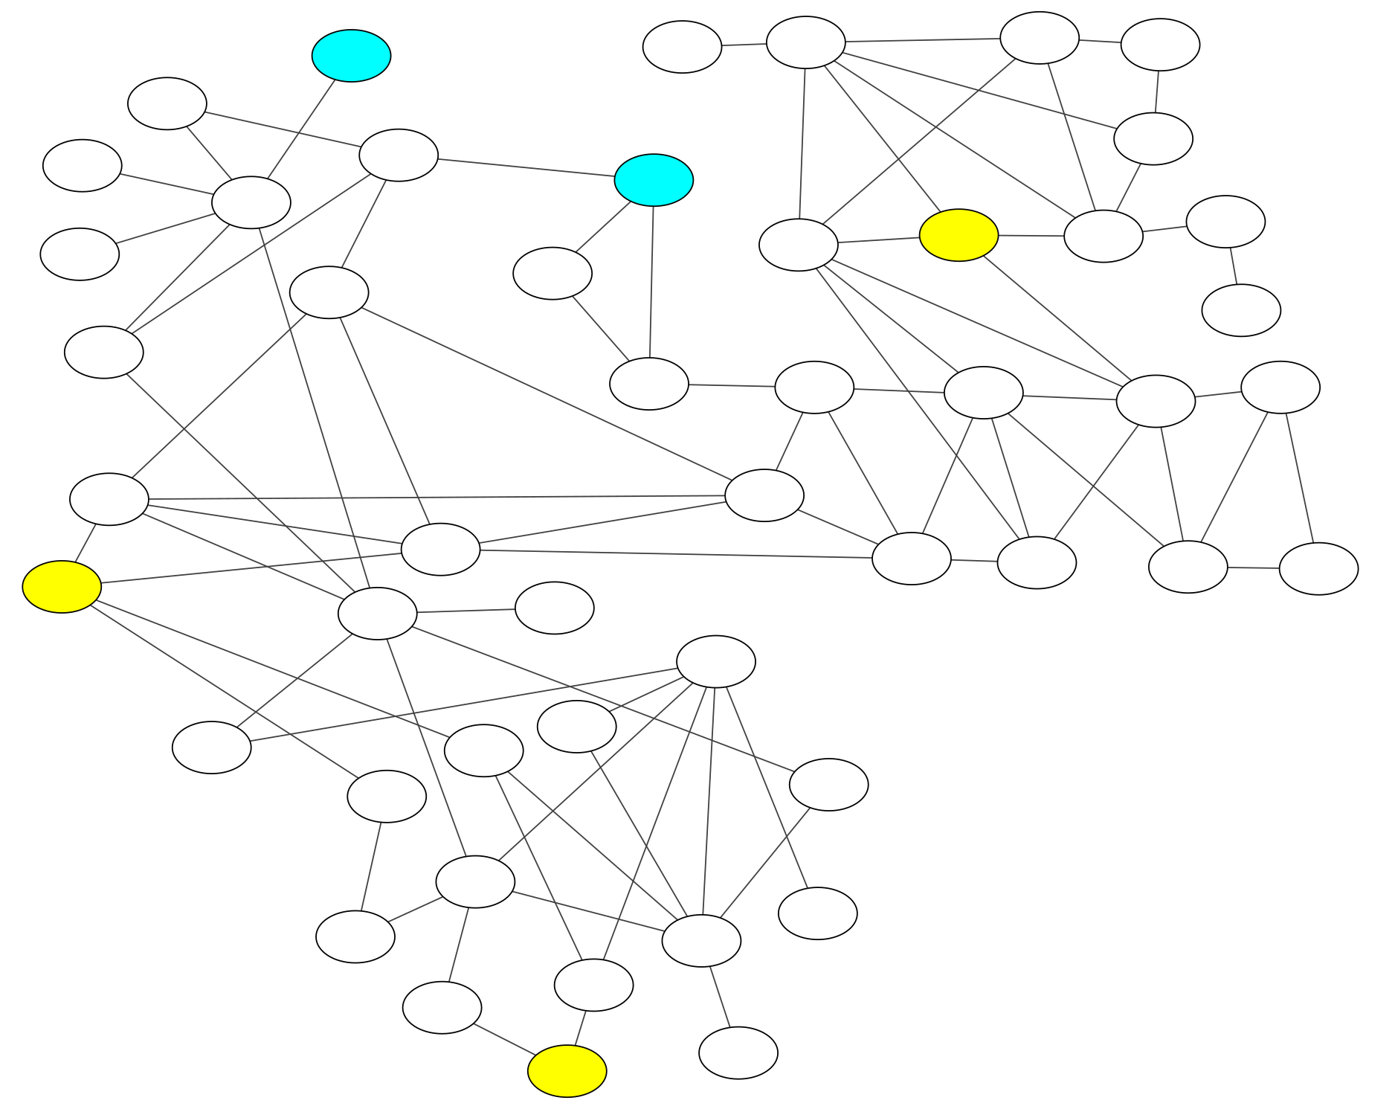

Slide 2
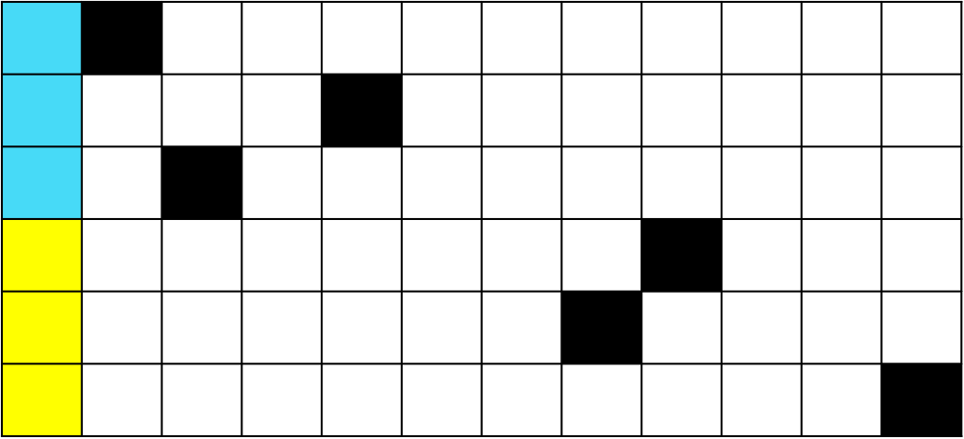
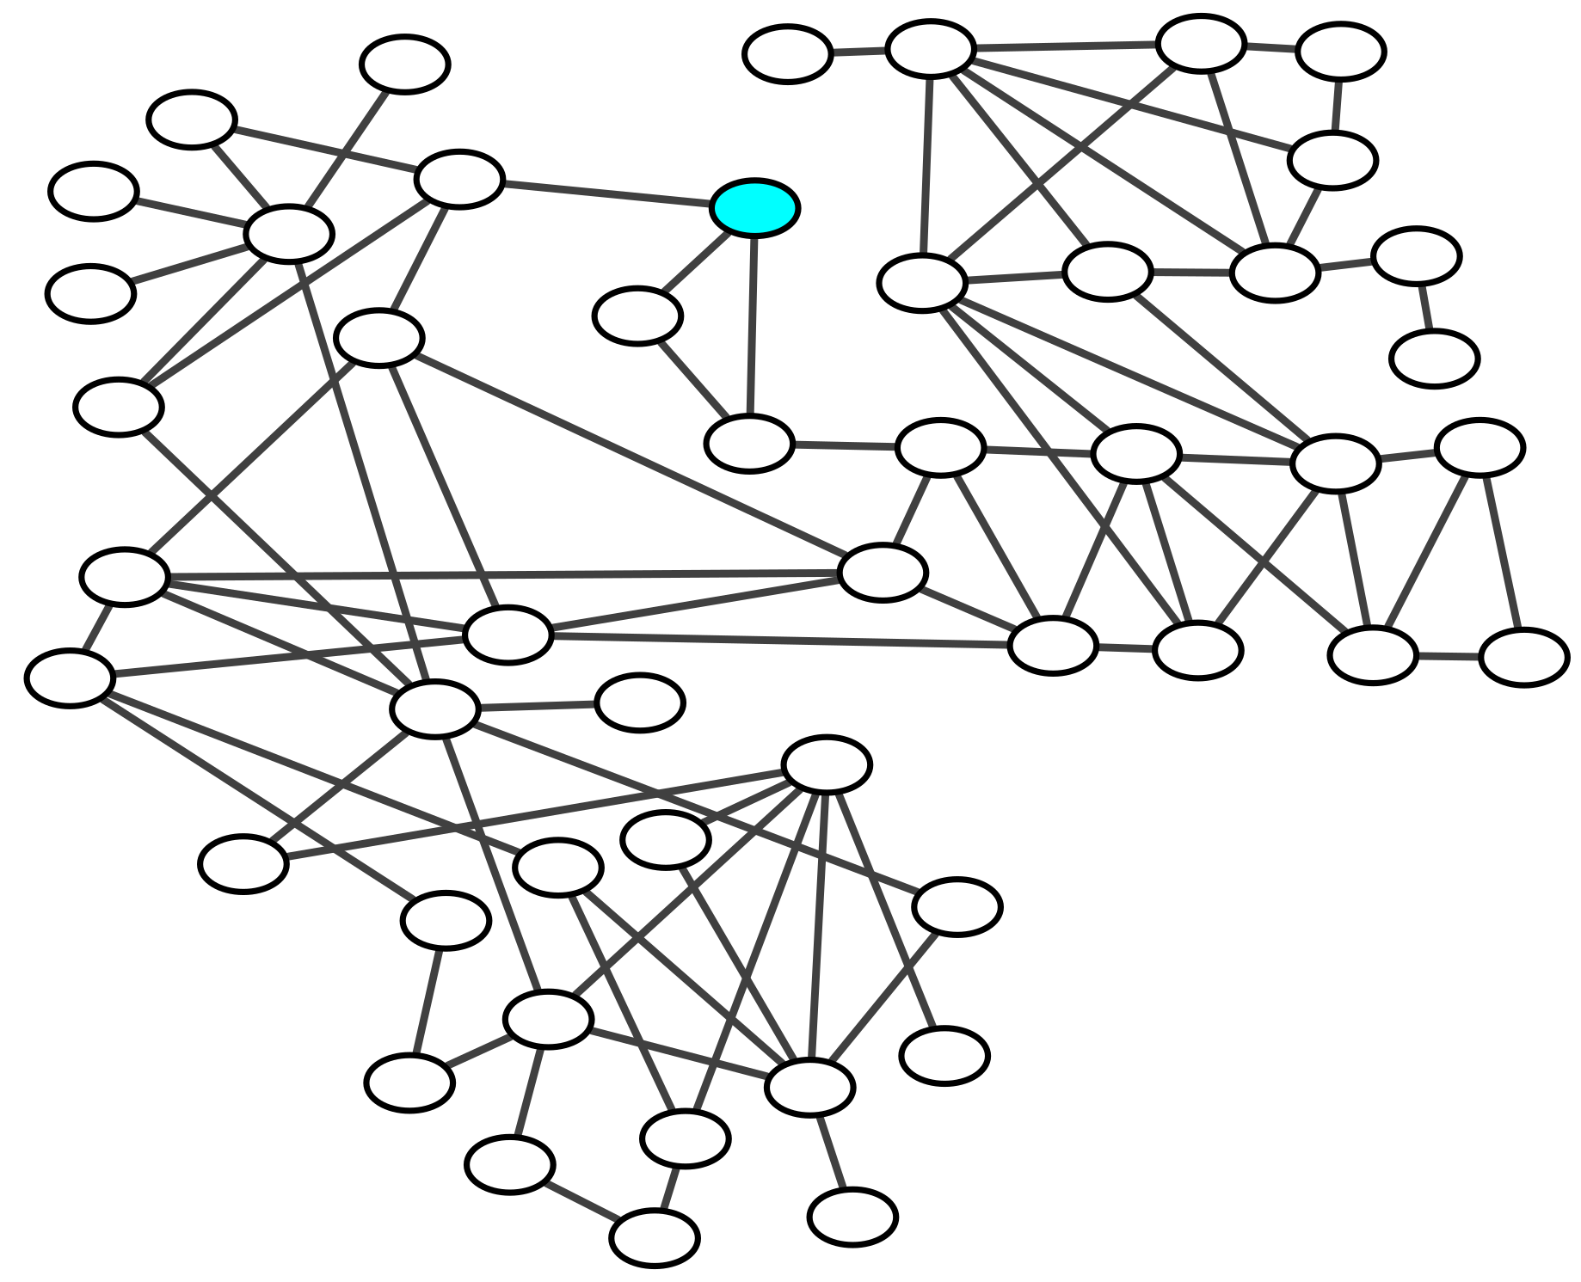
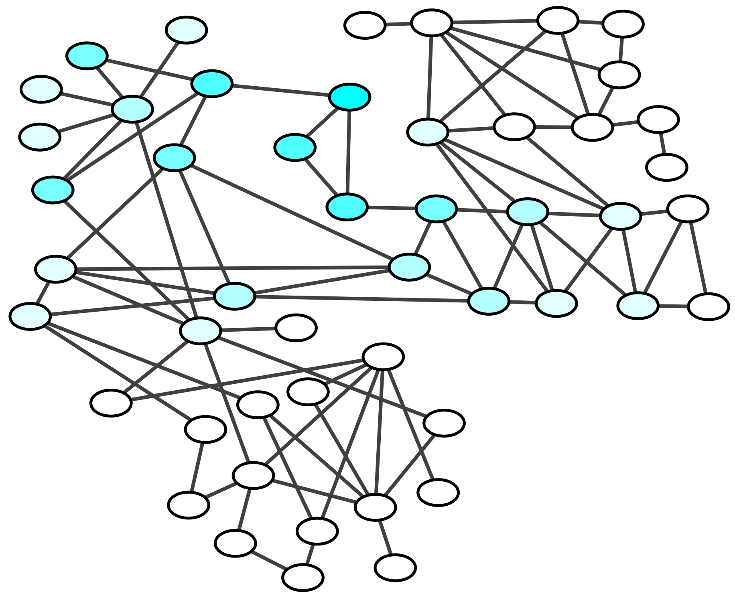
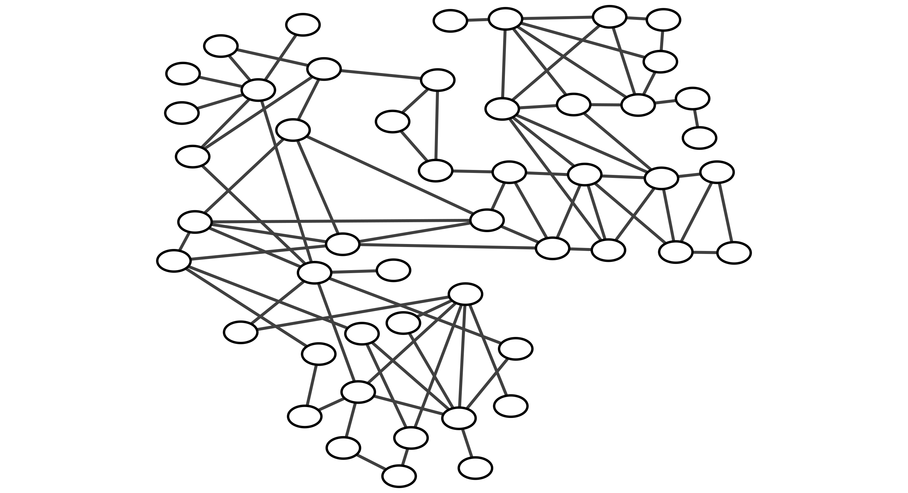
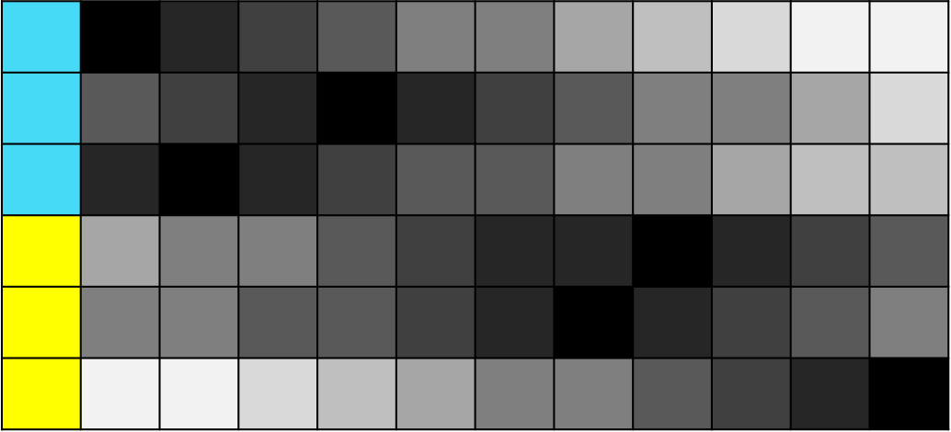
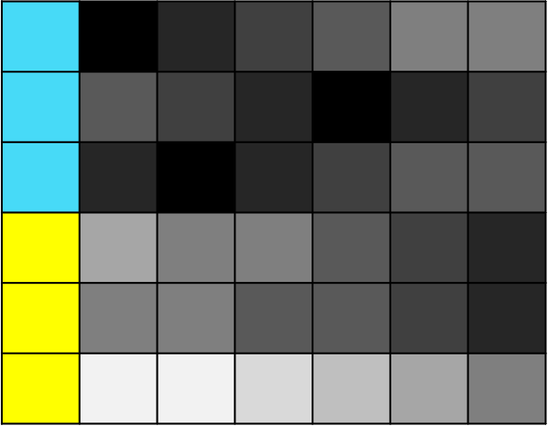
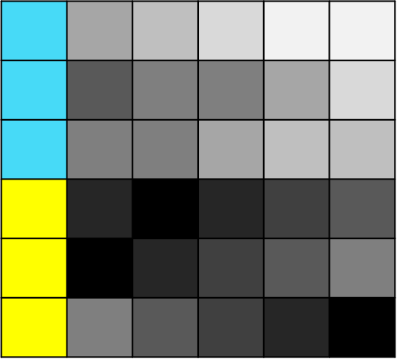



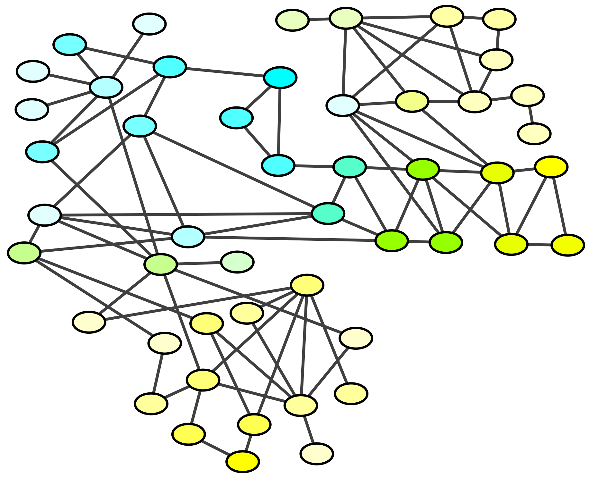







A
Genes
B
binary patient mutation profiles
Patients
Blue patient mutation
Smoothed blue patient mutation
Gene-Gene interaction network
Smooth
Yellow class
Blue class
Data preparation
smoothed mutation profiles
Smooth
Divide
pathway specific mutation profiles
….
Apoptosis
Glycolysis
Convert
C
FAS system on PSNs modelling pathways
of the combined mutation network
pathway specific patient similarity networks (PSNs)
Friends Against Strangers selection
top class discriminative pathways/PSNs
Glycolysis p.v: 0,04 ☑
Apoptosis p.v.: 0,03 ☑
Urea cycle p.v. 0,9
Feature selection and test patient classification
Classify patients
(Training) Feature selected pathways per patient class (Testing) unknown patients prediction
Strength evaluation against database
PSN
Strongest class detection
☑
Produce
Model performances
Most feature selected pathways per class
vs
Notes:
FAS system

Slide 3
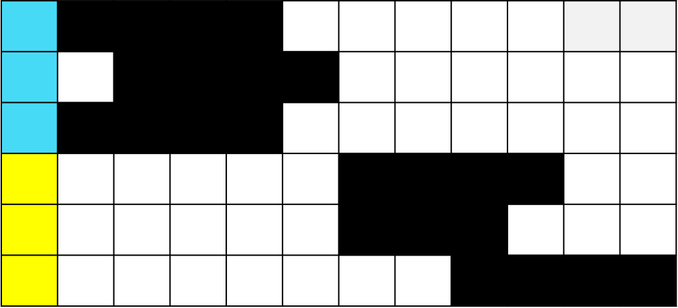
A
Genes
B
binary patient mutation profiles
Patients
Blue patient mutation
Smoothed blue patient mutation
Gene-Gene interaction network
Propagation
Yellow class
Blue class
Data preparation
smoothed mutation profiles
Smooth
Binarization
new binary patient mutation profiles
Notes:
FAS system

Slide 5
Notes:
We are representing a set of patients or pathways by the avg of their features because most of the PSNs are not predictive of a class and do not discriminate strongly the patients. This means that:
PAVGnew=how much a hypothetic non-predictive pathway makes its patients unbalanced. However, for the assumption PAVGnew reproduces a PSN very balanced; because it has a lot of indiscriminate and balanced patients.
Cnew=how much the patient C is unbalanced and discriminated over all the pathways. However, Cnew will assume a value that for the assumption will represent a very balanced C.
P3survival_diff=how many patients a hypothetic balanced pathway saves for the class that it is considered predictive.

Slide 6
Notes:
We are representing a set of patients or pathways by the avg of their features because most of the PSNs are not predictive of a class and do not discriminate strongly the patients. This means that:
PAVGnew=how much a hypothetic non-predictive pathway makes its patients unbalanced. However, for the assumption PAVGnew reproduces a PSN very balanced; because it has a lot of indiscriminate and balanced patients.
Cnew=how much the patient C is unbalanced and discriminated over all the pathways. However, Cnew will assume a value that for the assumption will represent a very balanced C.
P3survival_diff=how many patients a hypothetic balanced pathway saves for the class that it is considered predictive.

